Slide 1
Q.A. III
DBZP pY´= (pH)
EDTA-Ca
(trazo rápido por ZP)
__________________________________
Prof. Alejandro BAEZA
F.Q. UNAM - 2025-I

Slide 2

Preludio: DUZP
pH
2
3
6
10
CaHY⁻
CaY²⁻
Ca²⁺
CaOH⁺
3.5
13
pH
CaY²⁻
Ca²⁺
11
pY

Slide 3
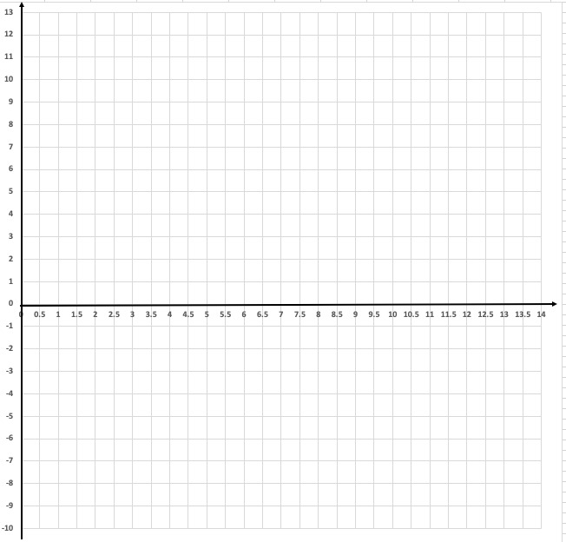



VII
VI
V
IV
III
II
I
1) Líneas guía:
Ca
C$aY$
pY = pKc´
Y
pKc
HY
pH
Ba
pH
BaHY
H₂Y
BaY
HY
Y
H₄Y
H₃Y
Ca
CaOH
C$aHY$
C$aY$

Slide 4
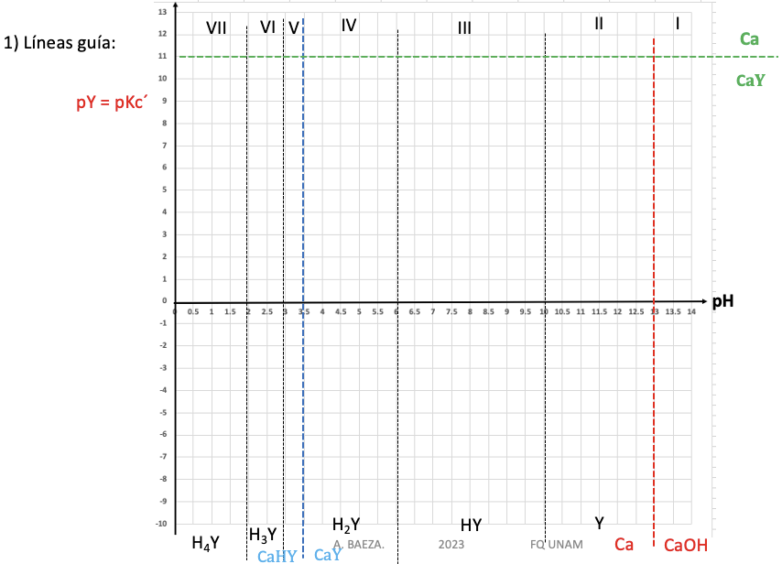







Zona I
${CaOH}^{+}+Y^{4−}+H^{+} ⇌ {CaY}^{2−}+ H_{2 }$O
$$K=\left[Y^{4−}\right]\left[H^{+}\right]$$
$$\left[Y^{4−}\right]=\frac{K}{\left[H^{+}\right]}$$
log $\left[Y^{4−}\right]= \log{K}−\log\left[H^{+}\right]$
-log $\left[Y^{4−}\right]= −log{K}+ \log\left[H^{+}\right]$
$$pY=pK+pH$$
Y : X
Y : H
Y=1 : H= 1
m= +1
${CaOH}^{+}+Y^{4−}+H^{+} ⇌ {CaY}^{2−}+ H_{2 }$O

Slide 5





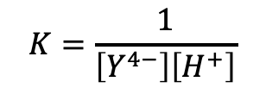
Ca
Zona I
CaOH
C$aY$
${CaOH}^{+}+Y^{4−}+H^{+} ⇌ {CaY}^{2−}+ H_{2 }$O
$$K=\frac{1}{\left[Y^{4−}\right]\left[H^{+}\right]}$$
$$\left[Y^{4−}\right]=\frac{1}{K\left[H^{+}\right]}$$
log $\left[Y^{4−}\right]=−\log{K}−\log\left[H^{+}\right]$
-log $\left[Y^{4−}\right]= +log{K}+ \log\left[H^{+}\right]$
$$pY=pK−pH$$
Y : X
Y : H
Y=1 : H= 1
m= -1
${CaOH}^{+}+Y^{4−}+H^{+} ⇌ {CaY}^{2−}+ H_{2 }$O

Slide 6







Ca
Zona II
CaOH
C$aY$
$${Ca}^{2+}+Y^{4−} ⇌ {CaY}^{2−}$$
$$K=\left[Y^{4−}\right]$$
$$\left[Y^{4−}\right]=K$$
log $\left[Y^{4−}\right]= \log{K}$
-log $\left[Y^{4−}\right]= −log{K}+$
$$pY=pK$$
Y : X
Y : H
Y=1 : H = 0
m= 0

Slide 7

Ca
Zona II
CaOH
C$aY$
$${Ca}^{2+}+Y^{4−} ⇌ {CaY}^{2−}$$
$$K=\left[Y^{4−}\right]$$
$$\left[Y^{4−}\right]=K$$
log $\left[Y^{4−}\right]= \log{K}$
-log $\left[Y^{4−}\right]= −log{K}+$
$$pY=pK$$
Y : X
Y : H
Y=1 : H = 0
m= 0

Slide 8






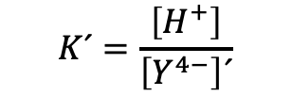

Ca
Zona III
CaOH
C$aY$
${Ca}^{2+}+{HY}^{3−} ⇌ {CaY}^{2− }$+ $H^{+}$
$$K´=\frac{\left[H^{+}\right]}{\left[Y^{4−}\right]´}$$
$$\left[Y^{4−}\right]´=\frac{\left[H^{+}\right]}{K´}$$
log $\left[Y^{4−}\right]=−\log{K+log\left[H^{+}\right]}$
-log $\left[Y^{4−}\right]= \log{K}−log\left[H^{+}\right]$
$$pY=−pK+pH$$
Y : X
Y : H
Y=1 : H = 1
m= +1
${Ca}^{2+}+{HY}^{3−} ⇌ {CaY}^{2− }$+ $H^{+}$

Slide 9




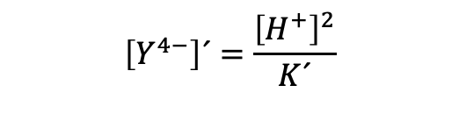
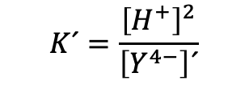

Ca
Zona IV
CaOH
C$aY$
${Ca}^{2+}+ H_{2 }Y^{2−} ⇌ {CaY}^{2− }$+ 2$H^{+}$
$$K´=\frac{{\left[H^{+}\right]}^{2}}{\left[Y^{4−}\right]´}$$
$$\left[Y^{4−}\right]´=\frac{{\left[H^{+}\right]}^{2}}{K´}$$
log $\left[Y^{4−}\right]=−\log{K+2log\left[H^{+}\right]}$
-log $\left[Y^{4−}\right]= \log{K}−2log\left[H^{+}\right]$
$$pY=−pK+2pH$$
Y : X
Y : H
Y=1 : H = 2
m= +2
${Ca}^{2+}+ H_{2 }Y^{2−} ⇌ {CaY}^{2− }$+ 2$H^{+}$

Slide 10

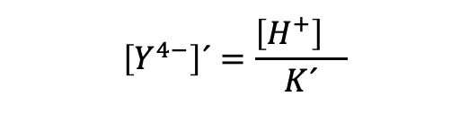
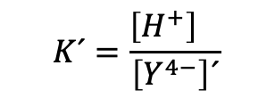
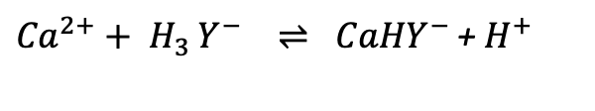
Ca
Zona V
CaOH
C$aY$
${Ca}^{2+}+ H_{3 }Y^{−} ⇌ {CaHY}^{− }$+ $H^{+}$
$$K´=\frac{{\left[H^{+}\right]}^{}}{\left[Y^{4−}\right]´}$$
$$\left[Y^{4−}\right]´=\frac{{\left[H^{+}\right]}^{}}{K´}$$
log $\left[Y^{4−}\right]=−\log{K+log\left[H^{+}\right]}$
-log $\left[Y^{4−}\right]= \log{K}−log\left[H^{+}\right]$
$$pY=−pK+pH$$
Y : X
Y : H
Y=1 : H = 1
m= +1
${Ca}^{2+}+ H_{3 }Y^{−} ⇌ {CaHY}^{− }$+ $H^{+}$

Slide 11


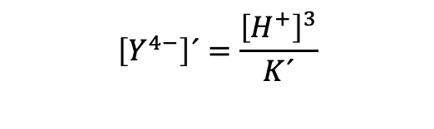
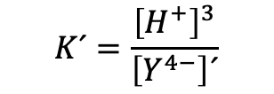



Ca
Zona VII
CaOH
C$aY$
${Ca}^{2+}+ H_{4 }Y ⇌ {CaHY}^{− }$+ ${3H}^{+}$
$$K´=\frac{{\left[H^{+}\right]}^{3}}{\left[Y^{4−}\right]´}$$
$$\left[Y^{4−}\right]´=\frac{{\left[H^{+}\right]}^{3}}{K´}$$
log $\left[Y^{4−}\right]=−\log{K+3log\left[H^{+}\right]}$
-log $\left[Y^{4−}\right]= \log{K}−3log\left[H^{+}\right]$
$$pY=−pK+3pH$$
Y : X
Y : H
Y=1 : H = 3
m= +3
${Ca}^{2+}+ H_{4 }Y ⇌ {CaHY}^{− }$+ ${3H}^{+}$

Slide 12

Zona VII
CaOH
Ca
${Ca}^{2+}+ H_{4 }Y ⇌ {CaHY}^{− }$+ ${3H}^{+}$
$$K´=\frac{{\left[H^{+}\right]}^{3}}{\left[Y^{4−}\right]´}$$
$$\left[Y^{4−}\right]´=\frac{{\left[H^{+}\right]}^{3}}{K´}$$
C$aY$
log $\left[Y^{4−}\right]=−\log{K+3log\left[H^{+}\right]}$
-log $\left[Y^{4−}\right]= \log{K}−3log\left[H^{+}\right]$
$$pY=−pK+3pH$$
Y : X
Y : H
Y=1 : H = 3
m= +3
${Ca}^{2+}+ H_{4 }Y ⇌ {CaHY}^{− }$+ ${3H}^{+}$

